Slide 1


Software Engineering Project 3rd Presentation
Tom Leonard and Lucas Villiere

Slide 2


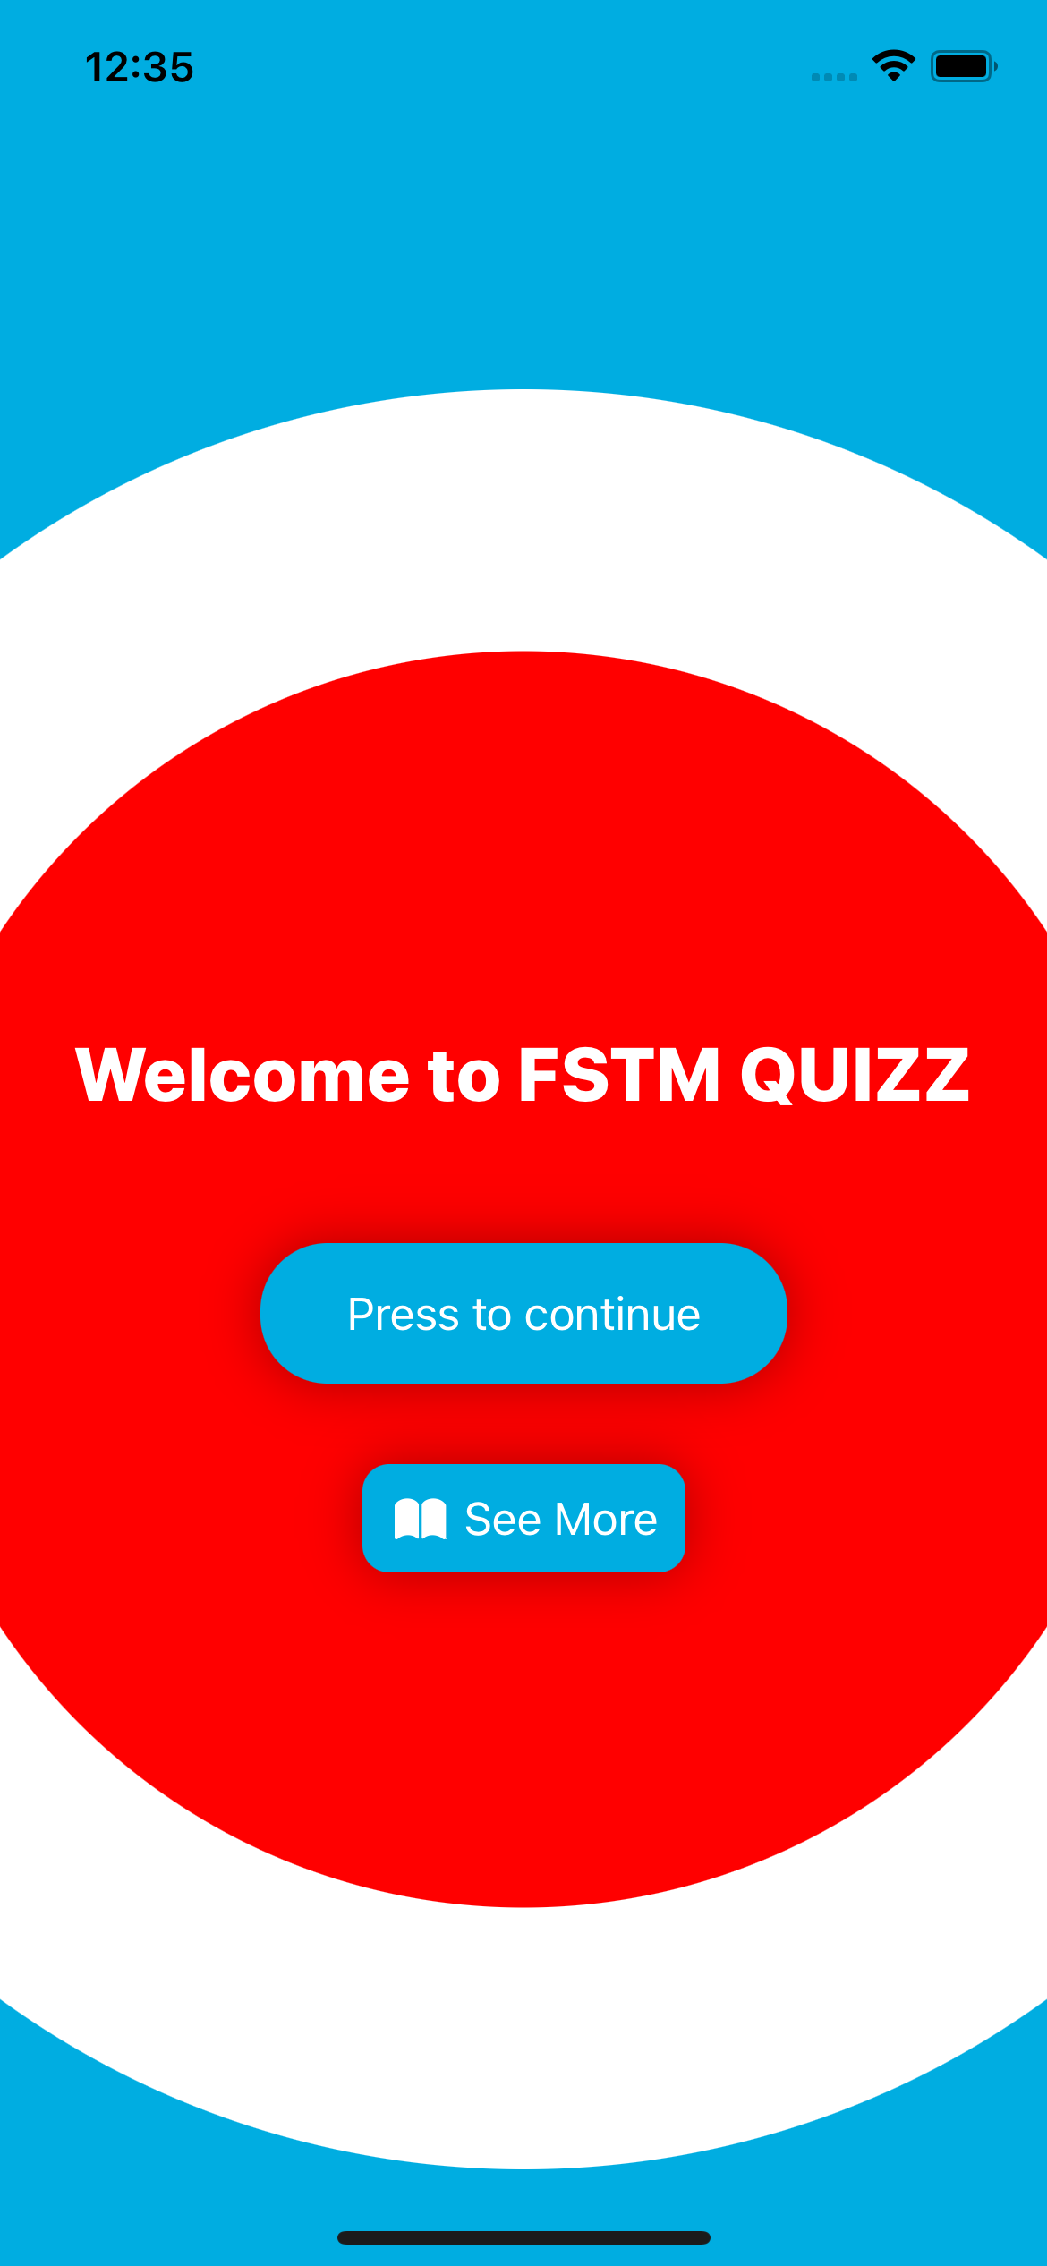
What was achieved in the first sprint ?
We created a nice-looking menu with 2 buttons :
The first one allows to play the game.
The second one allows to see more about the social media of the university and us ! (see more next slide)

Slide 3
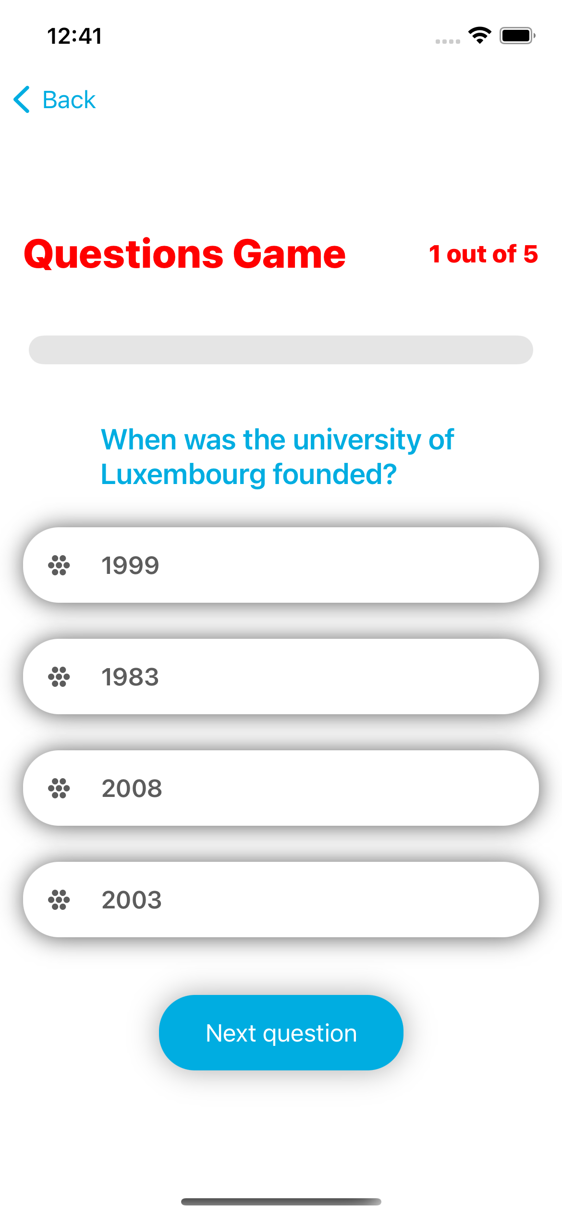
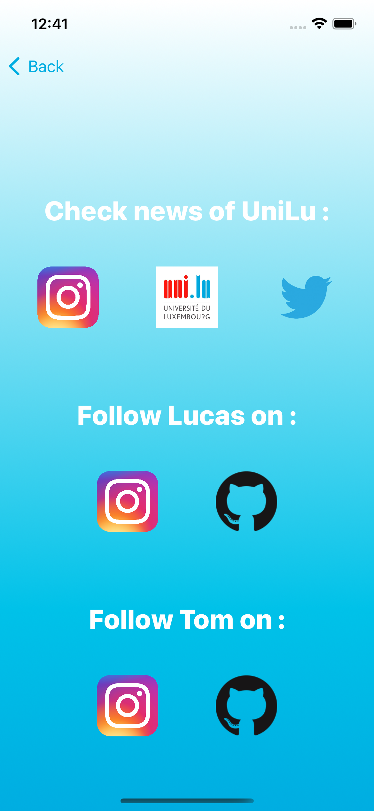

Slide 4
What was achieved in the first sprint ?
We started to implement a database in order to create the quizz.
We implemented some images that we stored inside the assets of Xcode and that we call from the Json.

Slide 5
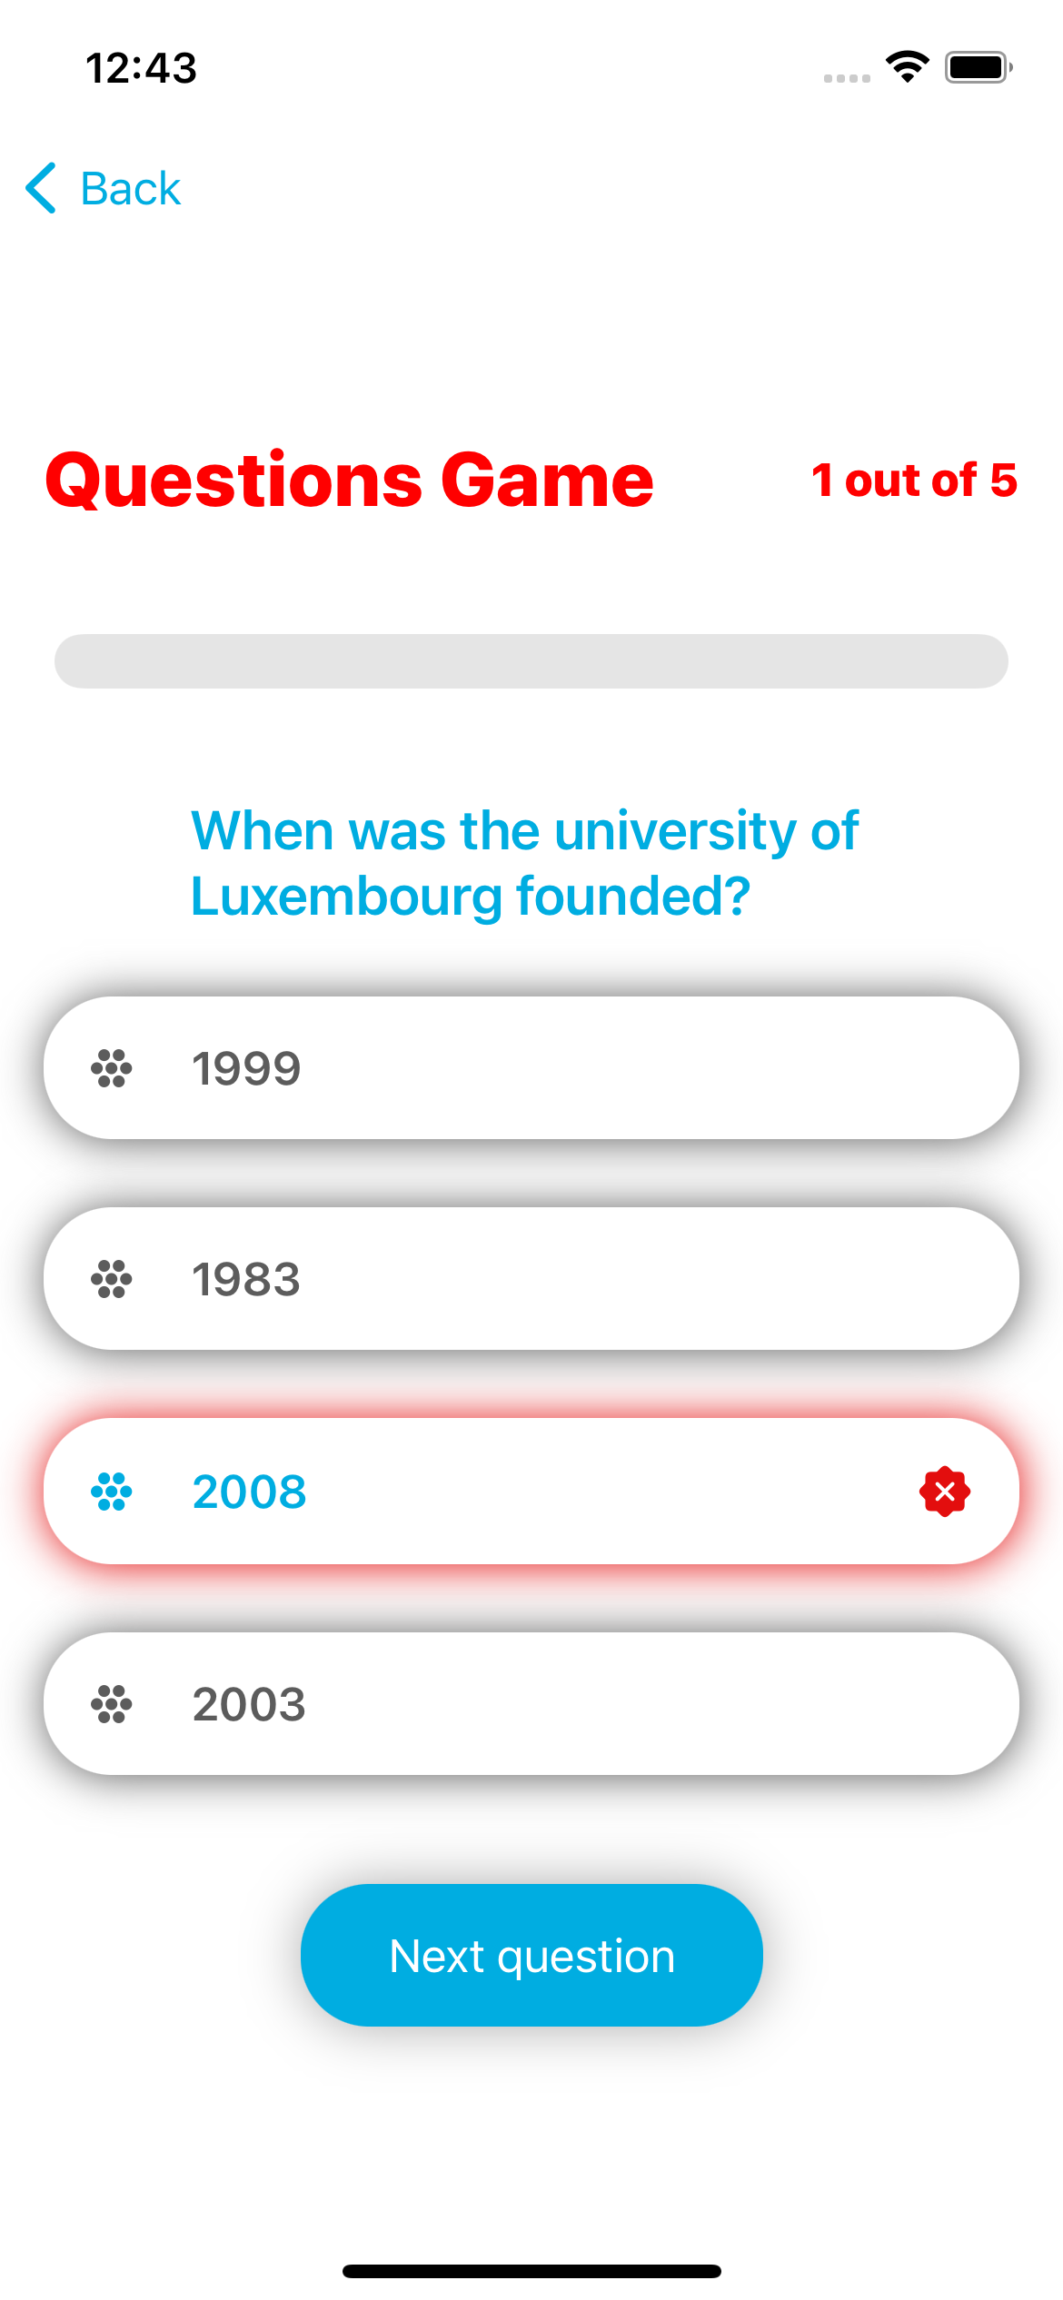
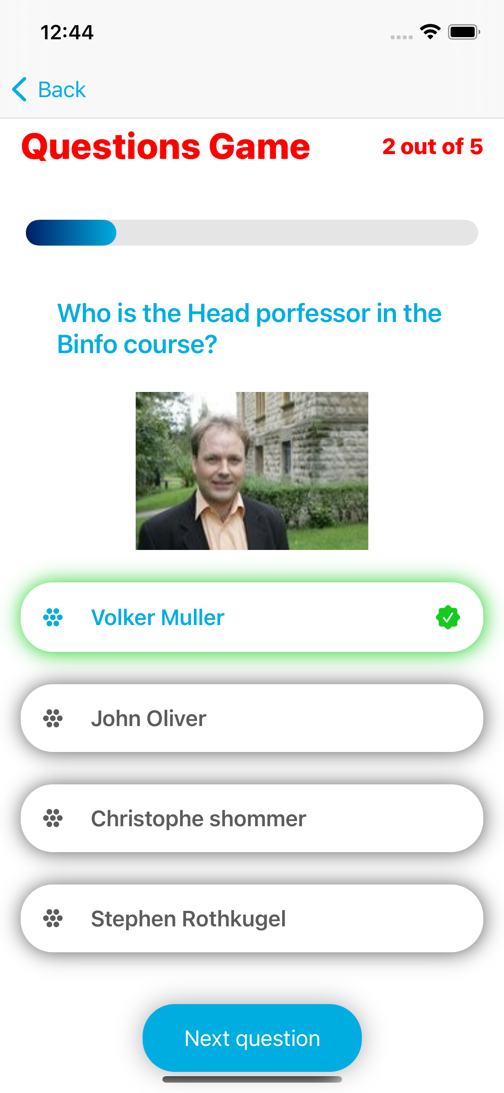
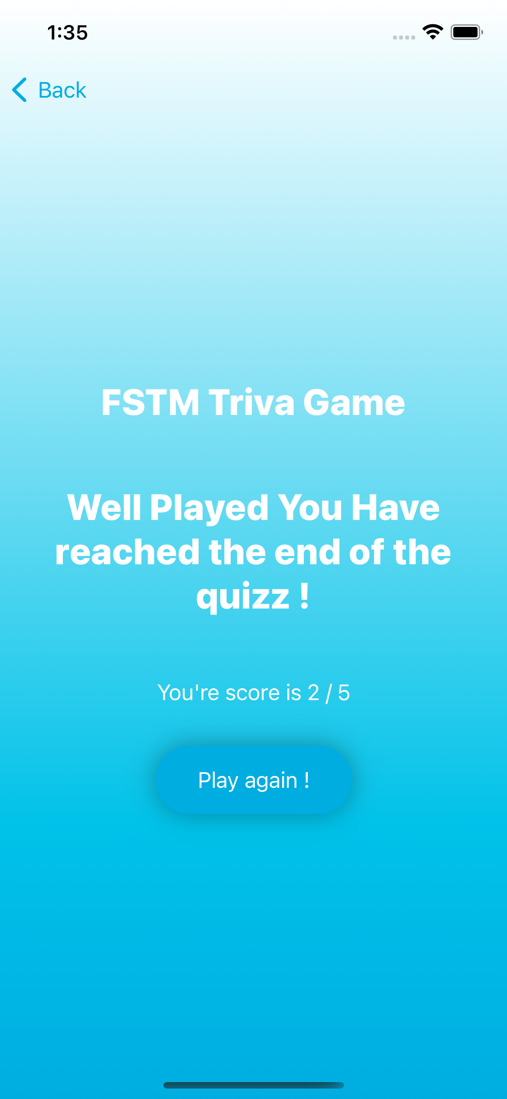

Slide 6
What is planned for sprint 2 ?
Create more questions for the main game.
Make the looking of the game better and some bug correction.
Creating a hangman game (if we have time).

Slide 7


Current problems and potential risks in the project ?
Some bugs (bugs are everywhere we never know if we’ll have some important ones !)
The time regarding doing the hangman (maybe it will take more time than we think)

Slide 8
Any questions ?

